Slide 1
The Purpose of this document
This document is a teaching tool presentation on how I might put together Project 3 in the University of Toronto boot camps. This project proposal is a start-to-finish high-level view of creating an elementary data platform with a JavaScript-based dashboard. This presents some basic how to set this up and my opinion on the best of the best as far as technology combinations for beginners looking to move into a data career.
It is, of course, opinionated based on experience.

Slide 2
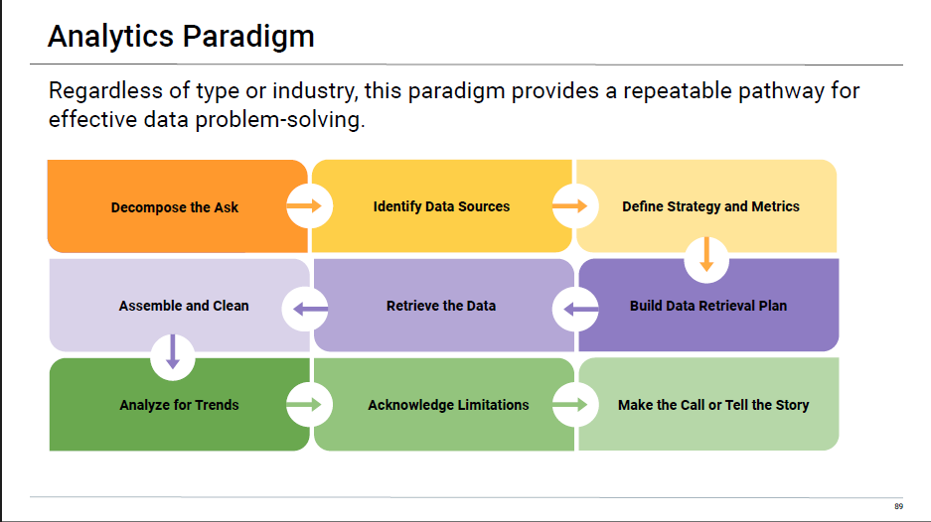

Slide 3
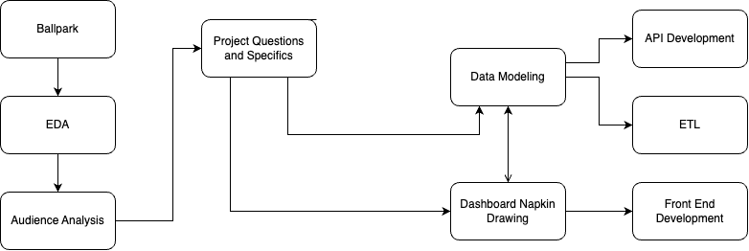
Core Milestones of Dashboard Product

Slide 4
Consensus required on Ballpark
What is the general topic ballpark, the actual goal will change after EDA and Data Collection.
Must be the consensus.
Understand the actual ask.

Slide 5

EDA is a Team Sport
Everyone has to know about the data to proceed
Should be day 0 and completed fast.
Informs other components.
If one person skips this, the group suffers.
No Output product.

Slide 6

Decide or Understand the Audience
Decide the specifics after the team does the EDA
Before working on the WHAT, work on the
WHO and the WHY.
Key Document Produced: User profile
Individual Goals
Individual Concerns of Stakeholders
Usually a dashboard has a limited number of Key stakeholders
This Photo by Unknown Author is licensed under CC BY

Slide 7
The What
Decide the core questions your User profile can answer for themselves via the dashboard.
With no stakeholder demands, get consensus on those questions.
Remember you have different views.
Deliverable: 5-7 questions that can be answered by the dashboard.

Slide 8
Data Modeling
Napkin Drawing
What would we like to collect?
Must include the Core data needed by the Napkin Drawing, but could include more.
Deliverable: Database Schema
What do we need to present, to answer the questions.
Deliverable: Napkin Drawings of the Dashboard via web pages. Mock up all the webpages, but most import at this stage is the dashboard components so you can figure out what data you need.

Slide 9
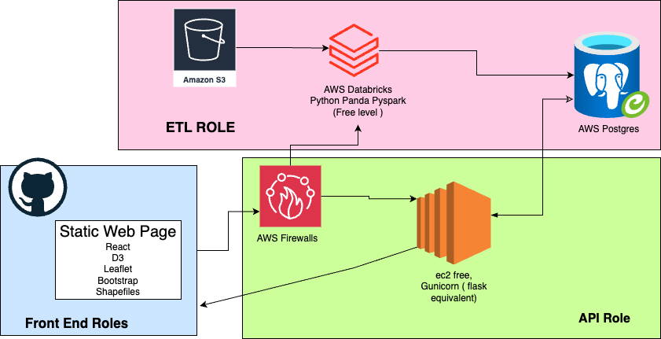
Simple Technical Architecture ( For ETL )

Slide 10
Pages to Include in your Application
Core Dashboard
Introduction ( Probably home the Home page)
About us, include your content details) and git.
Analysis ( optional )

Slide 11
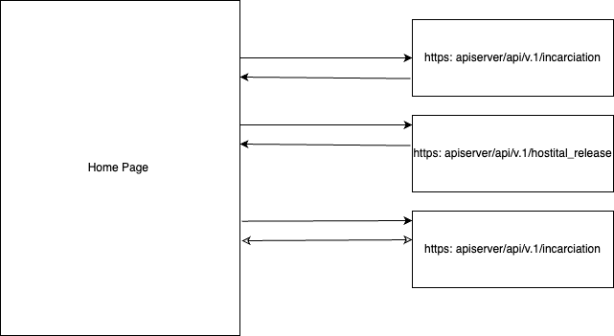

Slide 12
Mock Data is your friend and Next Step
At this point, it is important to lay out what the routes of the API will be.
Does not have to have real data, only that these will be the routes should be and what type of data is in each route.
The entire team should create fake JSON files of data from each route. These mock JSON serve as the standard the API team produces, and the front end team should expect.
Why do this? The front-end team can get to work without waiting for the ETL and API parts to be finished. They just code off the mock data until the real data is ready.

Slide 13
All Teams can Begin.
Once JSON files are created, all teams are unblocked and can start.
API has the schema even if the data will change.
Front End has the API routes, and what they can code against.
ETL is not holding this project up.

Slide 14

This Photo by Unknown Author is licensed under CC BY

Slide 15

The Game has Changed
Overall 80% of people out of bootcamps and school do eventually get work.
We can speed the process of that up.
The goal of the bootcamp is not the grade or to finish the challenge, it is to get a job.
The bare minimum won’t cut it for that purpose. Consider this project as the first portfolio project you would send to employers
This Photo by Unknown Author is licensed under CC BY-SA-NC

Slide 16

Beyond the Requirements
This sample project goes beyond the requirements but not employer requirements.
Additional Resume Skills
AWS
Beginning Architecture
Cloud Based ETL
Full Stack Development.
LIVE Web page is a high cool factor for a data bootcamp

Slide 17

Look Beyond the Project
Consider creating a blog if you spend over 15 minutes looking something up.
Share this on Linked In.
Working on a project to host these,
Torontodata.ca
( not ready yet, but let me know if you are interested)
Curated by Me.
For past and present students.
This Photo by Unknown Author is licensed under CC BY

